Slide 1
Unit 4: Week 5
Grade K

Slide 2
Copyright © Savvas Learning Company LLC. All Rights Reserved.
This publication is protected by copyright, and permission should be obtained from the publisher prior to any prohibited reproduction, storage in a retrieval system, or transmission in any form or by any means, electronic, mechanical, photocopying, recording, or otherwise. For information regarding permissions, request forms, and the appropriate contacts within the Savvas Learning Company Rights Management group, please send your query to:
Savvas Learning Company LLC, 15 East Midland Avenue, Paramus, NJ 07652
or
k12learningpermissions@savvas.com
myView Literacy® is an exclusive trademark of Savvas Learning Company LLC in the U.S. and/or other countries.

Slide 3
Lesson 1

Slide 4
Phonological Awareness
up
cup
at
hat
Notes:
Tell students that today they will add sounds to words to make new words. Display the up Picture Card. This picture shows the meaning of the word up. Say the word with me: up. Now listen as I add the sound /k/ to the beginning of up: /k/ -up. What is the new word? (cup)
Say the word at. Now say the word with me: at. Let's try adding different sounds to the beginning of this word. We'll begin with the sound /h/. Say the new word with me: /h/ -at, hat. What other sounds can we add to the beginning of the word at? Possible sounds include /b/, /k/, /m/, /p/, /r/, /s/, and /v/.

Slide 5
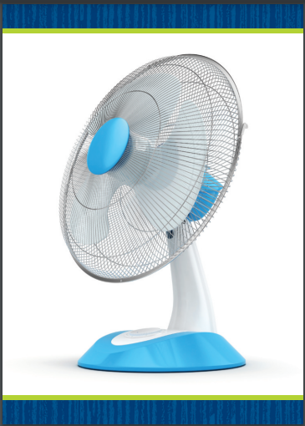
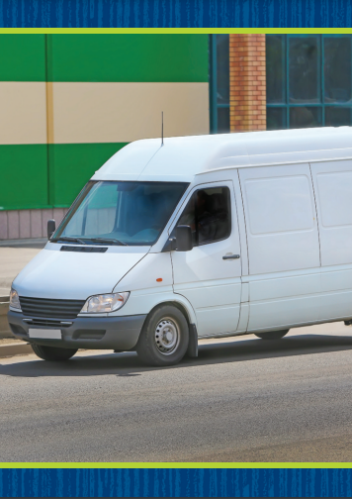
Phonics
Dd
Ff
Vv
Notes:
Write the letters Dd, Ff, and Vv on the board. Point to the letters and have students tell you the name and sound for each letter. Today we are going to work with words that have these letters and sounds.
Hold up the bed Picture Card. This is a picture of a bed. Turn the card over and cover the last letter with a self-stick note. Listen as I say the sounds for these letters: /b/ /e/. The last letter sound is missing. Who can tell me the last sound in bed? (/d/) What letter spells that sound? (the letter d) Uncover the letter d and read the word bed with students. Repeat with the fan and van Picture Cards, having students identify the letter f in fan and v in van.

Slide 6
Page 166
Phonics
Turn to page 166 in your Student Interactive and complete the activity.
Notes:
Have students turn to p. 166 in the Student Interactive. Have them read the first sentence, and guide them to figure out the missing letter. What sound goes at the beginning of ig? What is the letter for that sound? Students should say /d/, d. Have them write dig. Then have students complete the page.

Slide 7
High-Frequency Words
please
want
every
Notes:
Display the high-frequency words please, want, and every.
Read the words aloud.
Have students point to the word please and read it.
Repeat for want and every.

Slide 8
Page 164, 165
Interact with Sources
Draw a picture that shows a family tradition.
Notes:
Remind students of the Essential Question for Unit 4: What can we learn from the past? Then tell them the Weekly Question: What can we learn from family traditions? Explain to students that a family tradition is one way that we can connect to the past. By connecting to the past, we can learn about it.
Have students turn to pp. 164–165 in the Student Interactive. Tell them that they are going to hear a poem about a family tradition. Guide the discussion with the following prompts:
Read the poem aloud to students while they follow along.
Then ask students for their initial responses to the poem. Ask students if they know what the Fourth of July is. Ask if they know what camping is, or if they can picture a campfire or fireworks. Try to ensure that students understand all the important concepts mentioned in the poem. Then read the poem aloud again as they follow along.
Ask students to draw personal connections to the poem by saying how their own family traditions are similar to or different from the tradition described in the poem.
Ask students to describe familiar people, places, and things related to their traditions. Ask them who takes part in their family traditions. Ask students where they celebrate their traditions. Have them describe with detail any objects that are part of their traditions.
Have students interact with the poem by completing the drawing activity on p. 165 in the Student Interactive.
Remind students of the Week 5 Question: What can we learn from family traditions? Explain to them that they just heard and responded to a poem about a family tradition. The family in the poem camps out every Fourth of July. Other families have other traditions. Tell students they will learn about some other family traditions this week.

Slide 9
Listening Comprehension
“A Night at the Cogdells”
1. Celebration
2.
3.
4.
Notes:
Tell students that you are going to read a fictional text, or story, aloud. Stories have a theme. A story’s theme is the big idea or concept that the story is about. Have students listen as you read aloud “A Night at the Cogdells.” Remind students to be active listeners by looking at you and thinking about the story as you read.
Read the entire text aloud without stopping for the Think Aloud callouts.
Reread the text aloud, pausing to model Think Aloud strategies related to the genre.
Use a chart to help students recognize the characteristics of fiction. Tell them to help you list all the parts of the text that help us see what the text’s theme is. Ask them to say what the theme is.

Slide 10
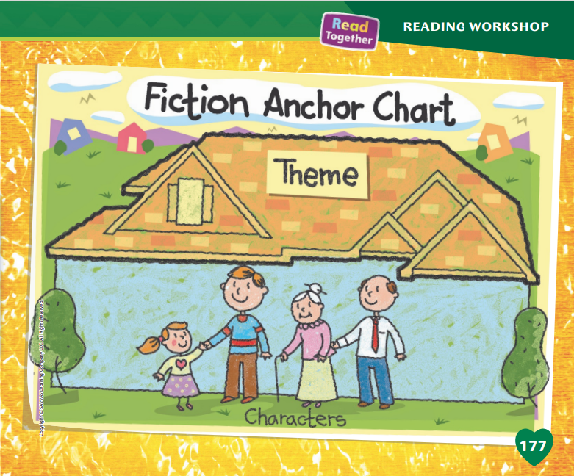
Page 176, 177
Fiction Qualities
Turn to page
176-177 in your Student Interactive.
Notes:
Explain to students that fiction has made-up characters. It also has a theme. Understanding a text’s theme can help readers understand the text better.
There are made-up characters in the text. They are not real people, but they can be like people you may know.
The theme is the big idea of the text.
A theme may be a lesson or something the author wants readers to learn or remember.
Remind students about the Read-Aloud story, “A Night at the Cogdells.”
The characters are two friends named Dalia and Imari.
The theme is family traditions. This is what the story is mostly about.
Turn to p. 176 of the Student Interactive. Read aloud the page and work with students to identify the characters and theme of the story about the Johnsons.
Have students look at p. 177. Editable Anchor Chart Click Path: Table of Contents -> Reading Anchor Charts -> Unit 4 Week 5: Fiction Editable Reading Anchor Chart

Slide 11
Page 176
Apply
How is the story like a narrative nonfiction story?
How is it different?
Notes:
Have students use the strategies for identifying fiction.
Have students complete the Turn and Talk activity on p. 176 of the Student Interactive. Have partners share their ideas with the class.

Slide 12
Page 193
Academic Vocabulary
Turn to page
193 in your Student Interactive and complete the activity.
Notes:
Explain to students that they can practice using the Academic Vocabulary words by talking with a partner.
Use new words in new ways. A partner can point out if you use a word incorrectly and help you use the word correctly.
Ask a partner to help you understand the meaning of a word if you are having trouble with the word.
Model using Academic Vocabulary words by talking about a photo that shows a family eating together on p. 249 of the Student Interactive. In this picture a family is eating together. They are smiling and they look happy, so I think they are celebrating. A tradition is something that a family can do to celebrate together. I can use the word tradition to talk about this picture. I can say, “The family has a tradition of eating a big dinner together.”
Have partners complete the activity on p. 193, using the Academic Vocabulary when they can.

Slide 13
Handwriting
it
kit
bit
Notes:
Explain to students that we write letters together to make words. Remind students that the letters in a word are not separated by spaces.
Write the word it on the board. Point to the word as you say it. We can write the word it by writing the letter i and the letter t next to each other. Show students how to write the word it. Have them practice tracing it on the surfaces of their desks. Write the word kit on the board. We can make this word by putting letters k, i, and t together. Have students practice tracing the word on the surface of their desks. Then repeat with the word bit.
Have students use Handwriting p. 208 from the Resource Download Center to practice writing Ww. Click path: Realize -> Table of Contents -> Resource Download Center -> Handwriting Practice -> U4W5L1 Handwriting Practice

Slide 14
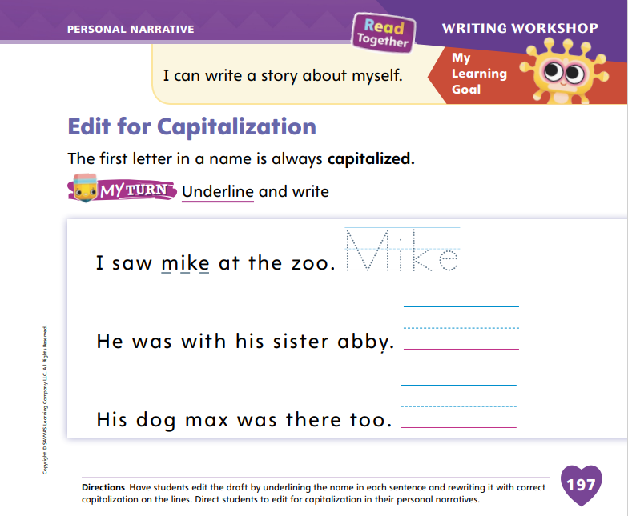
Page 197
Writing – Personal Narrative
Turn to page 197 in your Student Interactive.
Notes:
As authors edit their writing, they make sure they used capital letters correctly. Authors follow rules when deciding which words to capitalize. Capital letters:
start sentences.
show names of people and places.
show months, days of the week, and holidays.
Tell students that good writers go back and revise their work to make sure they have capitalized all the correct words in their books. Review the rules of capitalization using the list above.
Focus on capitalizing names. Explain that capitalizing the first letter of a name shows a reader that the word refers to a person or a named animal.
Review a stack text and point out the names in the story. Say: In this book, I see a word that begins with a capital letter. I know that names of people and animals begin with capital letters, so this must be a character’s or an animal’s name. When you write names in your own book, you should capitalize them, just like you capitalize your own name.
To practice editing for capitalization, write sentences from a stack book on the board, but change the capital letters to lowercase. Assist students in naming which words in the sentences should begin with a capital letter. Cross out the lowercase letter and write the capital letter above it.
Direct students to edit for capitalization on p. 197 of the Student Interactive.

Slide 15
Independent Writing
Revise your work for capitalization.
Decide which book you will share with the class on celebration day.
Share the revisions you made with the class.
Notes:
Have students look through their writing folders to revise their work for capitalization. Then have them continue writing or making final adjustments to their books.
Writing Support
Modeled - Write sentences with names in them and point out your use of capital letters.
Shared - As students share their ideas for revision, point out where capitalization is needed.
Guided - Guide students to use capital letters at the beginnings of the names of people or animals as well as at the start of a sentence.
Today, they should decide which book they will share with the class on Celebration Day.
Call on a few students to show their revisions to the class. Prompt the students to recall why capitalization is important in writing.

Slide 16
Spelling
We fed the dogs.
It’s time for bed.
We watch TV in the den.
We will take my cat to the vet.
Please help me with my homework.
We want chicken for dinner.
Notes:
(Note: Move the orange boxes to cover each bold spelling word before you read aloud the words and sentences.)
Read aloud the words and sentences. Have students spell each word with initial consonant blends and the two high-frequency words.
We fed the dogs.
It’s time for bed.
We watch TV in the den.
We will take my cat to the vet.
Please help me with my homework.
We want chicken for dinner.
Reveal the spelling word and have students check their work.

Slide 17
Language and Conventions
What did you eat for breakfast?
Take turns asking your partner “what” questions.
Notes:
Review with students that question words are words such as who, what, when, how, where, and why. Question words are words used to ask people for information.
Model for students how to ask a question with the word what. Ask: What did you eat for breakfast? Listen to students’ answers to the question.
Pair students and have them ask each other what questions and answer them in turn. If students can use the word what competently, encourage them to use other question words, such as how or why.

Slide 18
Lesson 2

Slide 19
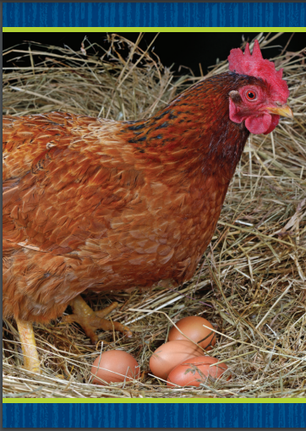
Page 167
Phonics
My pet is wet.
Jed will set it on top.
Her pet went to the vet.
Meg had a red vest.
Notes:
Hold up the hen Picture Card. This is a picture of a hen. What sound do you hear in the middle of hen? Have students identify /e/. The letter e spells the sound /e/ in hen. Turn the card over and read the word hen with students.
Say: Now let's practice reading more words with the sound /e/. Write this sentence on the board: My pet is wet. Read the sentence with students. Have students raise their hand when they hear a word with the sound /e/. Have volunteers circle the words with the sound /e/ spelled e. Continue with the following sentences: Jed will set it on top. Her pet went to the vet. Meg had a red vest.

Slide 20
Page 167
Apply
Turn to page 167 in your Student Interactive and complete the activity.
Notes:
Have students complete p. 167 in the Student Interactive.

Slide 21
High-Frequency Words
please
want
every
Notes:
Tell students that high frequency words are words that they will hear and see over and over in texts.
Write and read the words please, want, every.
Have students read each word.
Have students spell each word, clapping as they say each letter.

Slide 22
Page 178
Preview Vocabulary
served
sailed
shared
brought
Notes:
Introduce the following words from p. 178 in the Student Interactive: brought, served, sailed, shared.
Ask students what they already know about the words. Ask questions to help clarify meaning: Have you brought your lunch to school today? What have they served for lunch? Have you ever sailed on a sailboat? What types of things have you shared with your fellow students?

Slide 23
Page 179
First Read Strategies
Notes:
Discuss the First Read Strategies. In this first read, encourage students to read for understanding and enjoyment. After students complete the First Read, ask: What part of the story did you like most?
First Read Strategies
READ Read or listen to the text. During the first reading, work to understand what the text is about.
LOOK Look at the pictures to help understand the text.
ASK Generate, or ask, questions about the text to deepen understanding.
TALK Talk to a partner about the text.
Help students read the whole text independently, in pairs, or as a whole class. Use the First Read notes to help students connect with the text and to monitor comprehension.

Slide 24
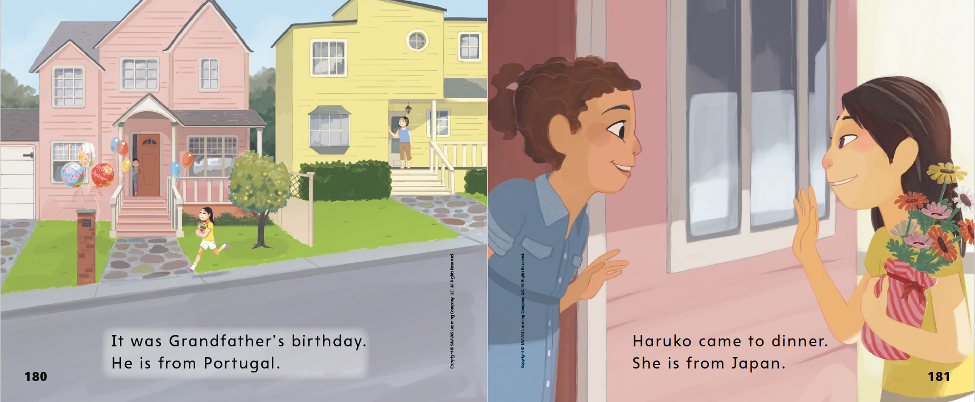
Page 180, 181
First Read – Tempura, Tempera
Notes:
Read Together.
THINK ALOUD The author wrote that Grandfather is from Portugal and that Haruko is from Japan. These are details. These details make me think of questions to ask the author. For example, I want to ask the author why she included these details. Why does it matter where Grandfather is from? Why does it matter where Haruko is from? I wonder if family traditions are related to where families are from.

Slide 25
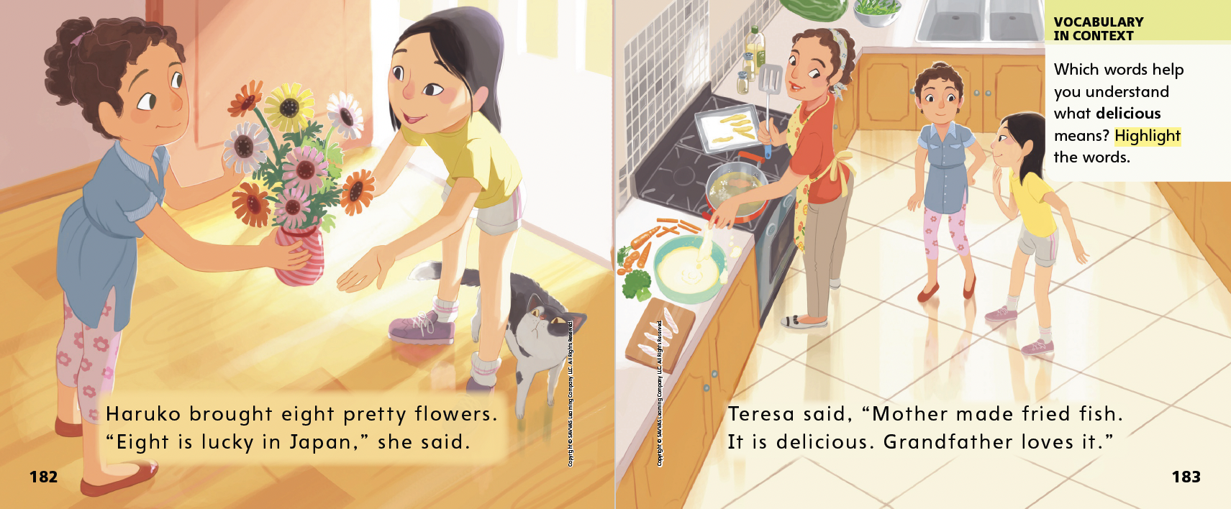
Page 182, 183
First Read – Tempura, Tempera
Notes:
Read Together.

Slide 26
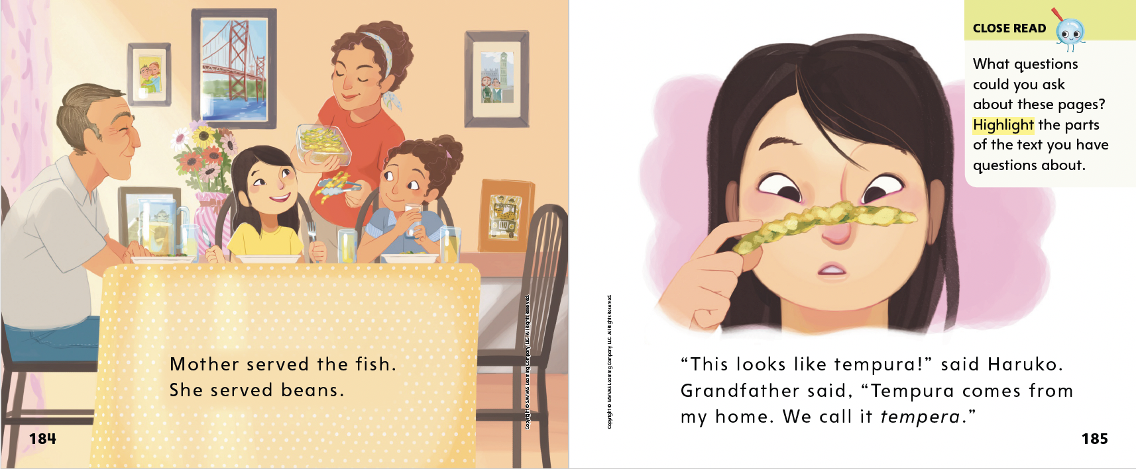
Page 184, 185
First Read – Tempura, Tempera
Notes:
Read Together.

Slide 27
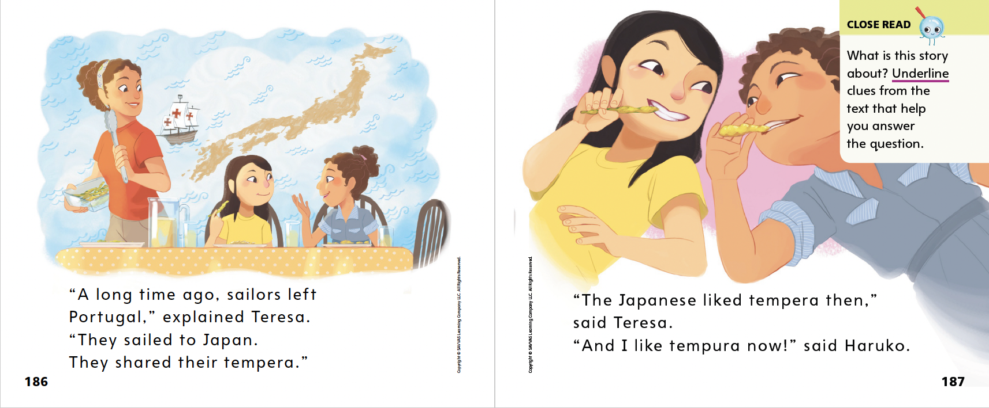
Page 186, 187
First Read – Tempura, Tempera
Notes:
Read Together.
THINK ALOUD When I ask questions about what I read, I can reread or read on to find the answers. As I read pp. 186–187, I see why it was important to know where Grandfather and Haruko are from. When I reread or read on with questions in mind, I learn more from my reading.

Slide 28
Respond and Analyze
Discuss: What did you think about the text? What did you like? What did you not like?
Illustrate: Draw what you thought the story was about.
Notes:
Ask students to give their initial responses to the text. Say: What did you think about the text? Was there anything you liked about it? Anything you didn’t like?
Talk Encourage students to share their responses by reminding them that there are no right or wrong answers to these questions. Listen to students’ responses and discuss them with the class.
Draw Ask students to draw what they thought the story was about.

Slide 29
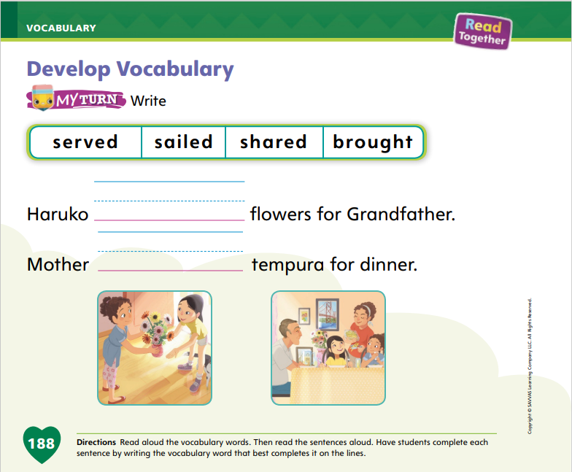
Page 188
Develop Vocabulary
Turn to page 188 in your Student Interactive and complete the activity.
Notes:
Tell students that they can learn or clarify the meanings of words by looking at the other words nearby in the text. This is called using context clues to learn and clarify meanings.
READ First read a phrase, sentence, or passage from a text.
ASK Then ask yourself if there are any words you do not know.
THINK If there is a word you do not know, think about what the other words in the sentence or passage mean. By using the meanings of words you already know, you may be able to learn and clarify the meanings of words that you do not know.
Have students turn to p. 188 in the Student Interactive. Go over the four vocabulary words, reviewing their meanings as necessary. Write a simple sentence frame with a blank for the vocabulary word shared on the board. Have students identify the correct vocabulary word to fill in the blank. Then have them do the same with the two sentences on p. 188.
Have students practice developing vocabulary by completing the activity on p. 188 in the Student Interactive.

Slide 30
Page 189
Check for Understanding
Turn to page 189 in your Student Interactive and complete the activity.
Notes:
Have students complete the Check for Understanding on p. 189 of the Student Interactive.

Slide 31
Page 198
Writing – Personal Narrative
Turn to page 198 in your Student Interactive and complete the activity.
Notes:
Authors edit their work to correct the spelling of high-frequency words and words with spelling patterns and rules.
Copy a sentence from a stack book on the board or flipchart. Change some of the words with spelling patterns or rules students are familiar with or high-frequency words they know so the words are spelled incorrectly. Say: Today we are going to edit our books to make sure every word is spelled correctly. Let’s practice editing this sentence. We will read the sentence together. Then we will check each word to see if it needs to be edited, or changed.
Work with students to identify the words that are spelled incorrectly. Cross out the word and write the correct word above it. Repeat with additional sentences until your class shows understanding. If students need help identifying words that are spelled incorrectly or editing the words, review spelling patterns and rules or high frequency words students have learned.
Have students complete the My Turn activity on p. 198 of the Student Interactive.

Slide 32
Independent Writing
Edit your narrative to make sure all words are spelled correctly.
Share your spelling revisions with the class.
Notes:
Have students edit their narratives to make sure all words are spelled correctly. Refer them to digital resources if they are not sure how to spell a word.
Writing Support
Modeled - Go back to the student’s writing and model editing spelling errors.
Shared - Have students identify any spelling errors in their writing.
Guided - Use a stack text to provide explicit instruction about how to edit spelling errors.
Then have them continue writing and editing the narrative they will be sharing on Celebration Day.
Call on a few students to show their revisions to the class, especially those demonstrating the ability to spell words correctly. Prompt students to explain why it is important to revise books.

Slide 33
Page 194
Spelling
Turn to page 194 in your Student Interactive and complete the activity.
Notes:
Explain that short e is often spelled with the letter e in words with three letters. Explain that this is the CVC, or consonant-vowel-consonant, pattern. Explain that knowing this pattern helps them read and spell words because words with this pattern usually have a short vowel sound.
Write or display these words with CVC short e: pet, men, led. Say each word aloud and point out the short e sound in each word.
Have students complete p. 194 in the Student Interactive.

Slide 34
Language and Conventions
How are you today?
Why is learning good?
Take turns asking your partner “how” and “why” questions.
Notes:
Tell students that question words are words that we use to ask people questions so that we can gain information.
Model for students how to ask questions with the words why and how. Ask: How are you today? Listen to students’ answers to the question. Then ask: Why is learning good? Listen to students’ answers.
Pair students, or have them form small groups. Have students ask their partners or group members how and why questions and answer them in turn. If students are comfortable using these question words, encourage them to use additional ones, such as when.

Slide 35
Lesson 3

Slide 36
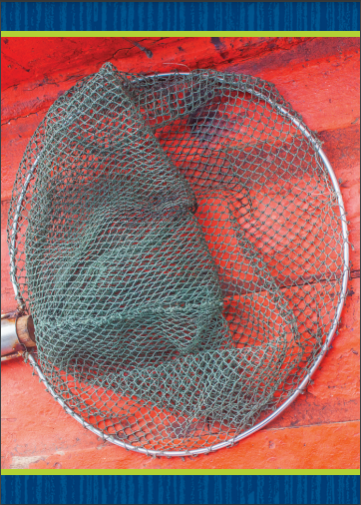
Phonological Awareness
Notes:
Display the net Picture Card. This is a picture of a net. Listen carefully as I say some words: net, bet, met. What can you tell me about these words? Students should say they rhyme. How do you know they rhyme? Students should say that the words have the same middle and ending sounds but different beginning sounds.
Hold up the jet Picture Card. Listen carefully as I say this word: /j/ /e/ /t/. Does jet have the same middle and ending sounds as net, bet, and met? Students should say yes.
Display the pen Picture Card and say the word pen. Ask a student to repeat the word and tell you one word that rhymes with it. Repeat the activity three more times, so you have at least four rhyming words. Answers may include: Ben, den, Jen, Ken, men, hen.

Slide 37
Page 168
Phonics
fed
vet
Turn to page 168 in your Student Interactive and complete the activity.
led
fin
end
vest
den
Notes:
Write the word fed on the board. This is the word fed. I hear the sounds /f/ /e/ /d/ in the word fed. We have learned all these sounds before. What sounds do we hear in the word fed? Students should say /f/ /e/ /d/. Have students identify the letter that spells each sound. Continue with the word vet.
Write the word led on the board. Let's identify the letter sounds and read this word together. Point to each letter and ask students to say the sound the letter spells. Now let's blend the sounds together: /l/ /e/ /d/, led. Continue the activity with fin, end, vest, and den.
Have students turn to p. 168 in the Student Interactive and take turns reading with a partner.

Slide 38
Page 169
High-Frequency Words
Turn to page 169 in your Student Interactive and complete the activity.
Notes:
Say: Today we will practice reading the high-frequency words want, every, and please. Have students read the words at the top of p. 169 in the Student Interactive with you: want, every, please.
Have students look at the words at the top of p. 169. Say: I will read a word, and I want you to point to it. Then we will read the word together. Read want, and have students point to it. Now let’s read the word together: want. Repeat with the other words. Ask students to use each word in a sentence.
Have students read the sentences on p. 169 with you. Ask students to underline the words want, every, and please in the sentences. Then have students read the sentences with a partner.

Slide 39
Page 179
Determine Theme
Notes:
Explain to students that many stories have a theme, or a big idea or meaning. The theme is the lesson or idea the author is trying to tell. Readers can figure out the theme by discussing topics and important details in the story and by thinking about their own experiences.
What is the story all about?
What do the characters do? What do they learn?
How do your own experiences help you understand the story?
Explain that using text evidence to determine the theme can help readers better understand a story. It can also help readers understand what the story means to them.
Model thinking about details to figure out the theme. Say: I want to figure out the big idea of Tempura, Tempera. I start by thinking about the topic, or what the story is all about. The story is about a girl who goes to a friend’s house for dinner. Next, I think about what the characters do. They eat food together and talk about where the food comes from. One time I went to a friend’s house to celebrate the Fourth of July. It was fun to see how our families’ traditions are alike and different. I think the theme of this story is that we can share traditions even though our families are different. Maybe we share more than we think we do!

Slide 40
Page 186, 187
Close Read – Determine Theme
Turn to page 186-187 in your Student Interactive.
Notes:
Have students look at pp. 186–187 and underline words that suggest what the story’s theme is. DOK 3

Slide 41
Page 190
Determine Theme
Turn to page 190 in your Student Interactive and complete the activity.
Notes:
Have students use the strategies for determining theme.
Have students complete the My Turn activity on p. 190 of the Student Interactive.

Slide 42
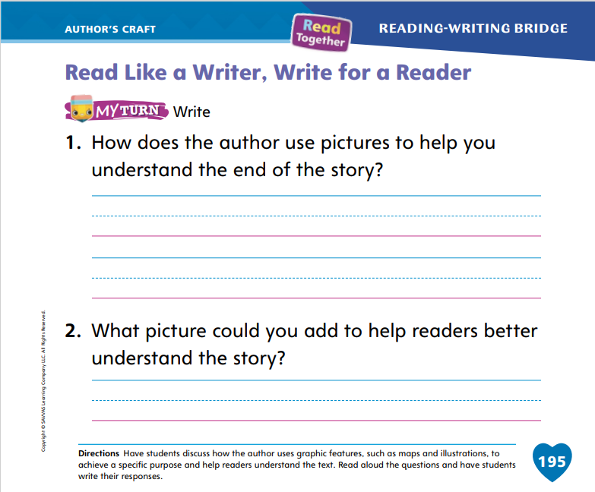
Page 195
Read Like a Writer, Write For a Reader
Turn to page 195 in your Student Interactive and complete the activity.
Notes:
Explain to students that authors use pictures to help show what their texts mean.
• Authors choose pictures or images that are closely related to what happens in the text. Readers can look at these images to better understand the text.
• Authors also use graphic features to add information about a topic.
Have students look at the picture on p. 179 of the Student Interactive. I ask myself what this picture has to do with the story. It shows a family eating dinner together. They are enjoying a tradition together. Because this picture is the first part of the story, it helps me guess what the story will be about before I read it. Ask students to look at another picture and talk about what it tells them about the text.
Have students complete p. 195 in the Student Interactive.

Slide 43
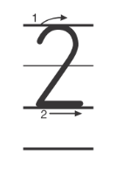
Handwriting
Notes:
Display the numerals 1 and 2.
Write the following sentence on the board: There is 1 apple. How many apples are there? Show me with your fingers. Model writing the numeral 1. Have students practice writing the number on the surface of their desk.
Write the following sentence on the board: There are 2 pigs. How many pigs are there? Show me with your fingers. Model how to write the numeral 2, having students copy your movements on the surface of their desk with their finger.
Have students use Handwriting p. 209 from the Resource Download Center to practice writing numerals 1 and 2. Click path: Realize -> Table of Contents -> Resource Download Center -> Handwriting Practice -> U4W5L3 Handwriting Practice

Slide 44
Writing – Personal Narrative
Your narrative should include:
People, setting, events
Narrator
Plot with a problem and resolution
Events that happen in time order
Edit for:
Punctuation marks
Verbs
Capitalization
Spelling
Notes:
Before they celebrate their writing, authors make sure to revise and finalize their work.
Make a Writing Checklist for students to refer to as they revise their writing, incorporating what they have learned in this unit. Their personal narrative should include
people, a setting, and events.
a narrator (usually the author).
a plot that includes a problem and resolution.
events that happen in time order.
This unit’s Writing Checklist can include
editing for punctuation marks.
editing for verbs.
editing for capitalization.
editing for spelling.
Reread each item on your lists. Ask students if they have any questions about what to check in their writing. Display your checklist so students can refer to it as they transition to independent writing.

Slide 45
Independent Writing
Revise your narrative using the checklist.
Share something your revised.
Explain why you made the revisions and how they improved your writing.
Notes:
Tell students to use the checklist to revise the narratives they created during this unit. Students should focus primarily on revising the book they are going to share on Celebration Day.
Writing Support
Modeled - As you look through student work, model using the checklist to revise.
Shared - Have students identify how their work can be revised as they refer to the checklist.
Guided - Prompt students to read the sentences in their narratives and direct them to use the checklist as they revise.
Call on a few students to share something they revised. Prompt students to explain why they made the revisions and how they improved their writing.

Slide 46
Spelling
pen
hen
ten
set
lad
Notes:
Review with students that in CVC words, the vowel usually has the short sound.
Write the word pen. I see a vowel between the two consonants. I know that this is a CVC word and the vowel is probably short. The word is pen. Write these words and have students practice reading them and spelling them aloud: hen, ten, set, led.
Have students complete Spelling p. 214 from the Resource Download Center. Click path: Table of Contents -> Resource Download Center -> Spelling -> U4W5

Slide 47
Language and Convention
When did you eat?
Where do you like to play?
When did you wake up today?
Work with your partner to ask when and where questions.
Notes:
Write the following questions on the board: When did you eat? Where do you like to play? Read the questions aloud to students, pointing out the question words when and where.
Model another example for students: When did you wake up today?
Tell them that the words when and where are used to ask questions about time and location—when things happen and where they happen. Asking questions is important because it allows them to gain new information. Call on volunteers to ask when and where questions.

Slide 48
Lesson 4

Slide 49
Page 170
Phonics
Turn to page 170 in your Student Interactive and complete the activity.
Notes:
Tell students that today they will read some sentences. The sentences you read will include sounds and high-frequency words you have already learned. You can look at the pictures to help you understand the sentences better.
Display a picture of an airport scene where a boy is sitting in a plane. Write the following sentences on the board: Ben is in a jet. Ben is next to a jet. Let’s read the sentences together: Ben is in a jet. Ben is next to a jet. Which sentence matches the picture? Yes, the sentence about Ben in the jet. Let’s circle that sentence.
Have students turn to p. 170 in the Student Interactive. Let’s read the first sentence: Ted had a big fan. Which picture matches that sentence? Yes, the picture of the boy and the fan. Let’s trace the line from the sentence to the picture.

Slide 50
Page 171
Decodable Story
please
want
every
Turn to page 171 in your Student Interactive.
We will read “We Have Fun.”
Notes:
Have students turn to p. 171 in the Student Interactive. We are going to read a story today about families who like to help out and have fun. Point to the title of the story. The title is We Have Fun. I see one word with the beginning sound /f/. What is it? Yes, it is Fun. Have students find and point to the word. In this story, we will read other words that have sounds you have learned.
Remind students of this week’s high-frequency words: please, want, every. Tell them they will practice reading these words in the story We Have Fun. Display the words. Have students read them with you. When you see these words in the story We Have Fun, you will know how to identify and read them.
Have students whisper read the story as you listen in. Then have students reread the story page by page with a partner. Listen carefully as they use letter sound relationships to decode. Partners should reread the story. This time the other student begins.
After students have read the story, review the words with the sound /e/ they read in the sentences on p. 171. Have them highlight the words with the sound /e/. Have students read the words to you.

Slide 51
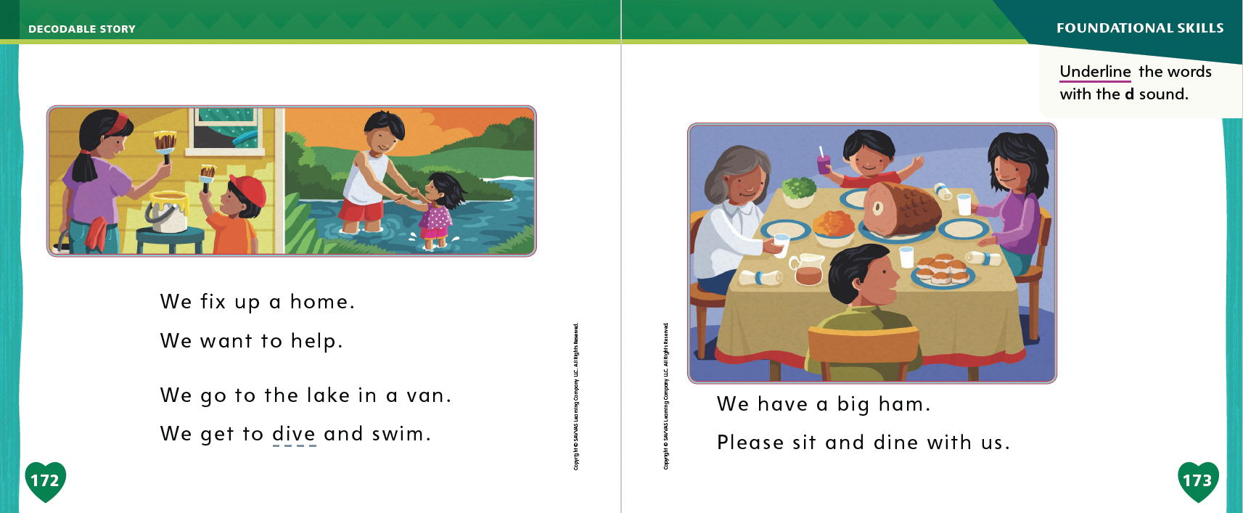
Page 172, 173
Decodable Story
Notes:
Call students’ attention to the sentences on p. 172. Which word has the beginning sound /d/? Point to it. Help students identify, or say, the sound /d/. Then have them find and underline the word dive. Which word has the beginning sound /v/? Point to it. Help students identify, or say, the sound /v/. Then have them say the word van. Which word has the beginning sound /f/? Yes, the word fix.
Have students look at the rest of the story on p. 173. Which word has the sound /d/? Point to it. Help students identify, or say, the sound /d/. Then have them find and underline the word dine.

Slide 52
Page 179
Ask and Answer Questions
Notes:
Readers ask questions before, during, and after reading to help them understand a text. Remind students to
Remember that most questions begin with who, what, where, when, why, or how.
Think about what they know about the theme. What more do they want to learn?
Look at the pictures. Do they have any questions about what they see?
Think about the details. Is there anything they need clarified?
Ask the teacher or another adult for help with questions or locating answers if they are having trouble.
Have students look at pp. 184–185 in the Student Interactive. Direct their attention to the Close Read note. Ask students to think about what questions they might have about the text or pictures on these pages. Have them highlight words that they want to ask questions about. I want to think of a question to ask. I will find a word that I have a question about. Here is the word beans. I wonder what the beans taste like. What kind of bean is the family eating?
Have students practice generating questions based on the content of pp. 184–185 in the Student Interactive.

Slide 53
Page 184, 185
Close Read – Ask and Answer Questions
Turn to page 184-185 in your Student Interactive.
Notes:
Read the Close Read note on p. 185. Have students share the text that they highlighted and their question about it. DOK 3

Slide 54
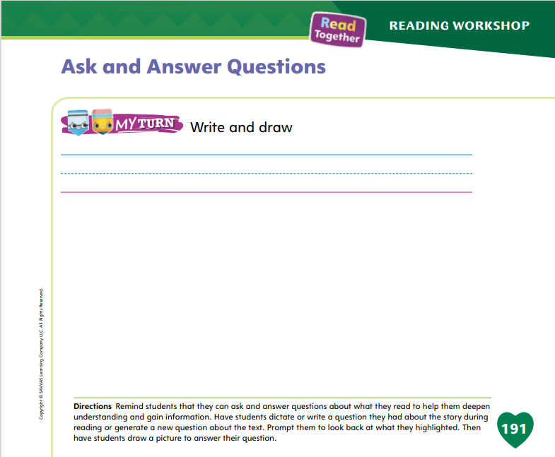
Page 191
Ask and Answer Questions
Turn to page 191 in your Student Interactive and complete the activity.
Notes:
Have students use the strategies for asking and answering questions.
Have students complete the My Turn activity on p. 191 of the Student Interactive.
Optionally, have students share their drawings with the class.

Slide 55
Writing – Personal Narrative
Today you will celebrate your writing by reading it to the class.
Remember to introduce yourself and speak slowly and clearly.
Notes:
One way to celebrate writing is to read it aloud for others to hear. Before reading a story, authors introduce themselves and tell the title of their personal narrative. During the celebration, the audience listens attentively to the author. After reading, they ask questions or make suggestions to help make the narrative better.
Tell students that you will celebrate your writing by reading it aloud to the class. You can share a story you wrote or read a stack book. Conduct a Think Aloud before sharing, recalling what to do when speaking to a group. Say: I recall I should introduce myself to the group. I should speak loudly and clearly so everyone can understand. I also recall that my audience should listen actively so they can make suggestions when I’m done reading.
Introduce yourself using a common greeting and read your story aloud, speaking slowly and clearly. When you are finished reading, tell students to ask questions and provide suggestions. Model using active listening and acknowledging student suggestions.

Slide 56
Independent Writing
Share your writing with the class.
Ask questions and provide positive feedback or suggestions to your classmates.
Notes:
Have students share their writing with the class. Prompt students to ask questions and provide positive feedback or suggestions.

Slide 57
Spelling
it
in
met
red
Notes:
Have students recall words with the VC and CVC patterns they learned in Weeks 3 and 4. Explain that they learned that the vowel sounds in these words are usually short.
Write these words: it, in, met, red. Have students identify the spelling patterns and then read the words. Cover the words and ask students to spell them.
Have students use the spelling patterns for at and vet to make a list of other words they can write with these patterns.

Slide 58
Page 196
Language and Conventions
Turn to page 196 in your Student Interactive and complete the activity.
Notes:
Have students complete p. 196 of the Student Interactive.

Slide 59
Lesson 5

Slide 60
Phonological Awareness
I run in the sun.
She has a big job.
Mom and Dad are at my game.
I go to school.
How many words are in each sentence?
Notes:
Tell students that today they will identify words in sentences and count how many words they hear. Say the following sentence: I run in the sun. Listen as I say the sentence again: I (clap) run (clap) in (clap) the (clap) sun (clap). I clapped five times. There are five words in this sentence.
Say the following sentences: She has a big job. Mom and Dad are at my game. I go to school. Have students clap for each word they hear and count the words in each sentence.

Slide 61
Page 174
Phonics
It is a bug.
It is a mug.
Turn to page 174 in your Student Interactive and complete the activity.
Notes:
Tell students that today they will read some sentences. The sentences you read will include sounds and high-frequency words you have already learned. You can also look at the pictures to help you understand the sentences better.
Show students a mug. Write these sentences on the board: It is a bug. It is a mug. Let’s read these sentences together: It is a bug. It is a mug. Which sentence tells about this object? Yes, the sentence It is a mug tells about the object.
Have students turn to p. 174 in the Student Interactive. Guide them as they decode the words in the first sentence and write the word van from the word bank to complete the sentence to match the picture. Have students complete the activity.

Slide 62
Page 175
Apply
Turn to page 175 in your Student Interactive and complete the activity.
Notes:
Have students look at p. 175 in the Student Interactive.
Have them write the correct letter to complete each word.
Then have them decode the sentences.

Slide 63
High-Frequency Words
please
want
every
Notes:
Remind students that high frequency words are words that appear over and over in texts.
Remind them they will be learning many high-frequency words this year, and the words will help them become better readers.
Say the word please and ask students what letters spell the word.
Have students:
say the letters in the word as you write the letters on the board.
say and spell the word, doing a silent cheer for each letter.
repeat with want and every.

Slide 64
Page 192
Reflect and Share
Turn to page 192 in your Student Interactive and complete the activity.
Notes:
Tell students they can retell different texts that they have read in order to find connections between the texts.
To retell a text is to say in your own words what the text is about and what happens in the text.
When you retell a text, you start at the beginning and tell what happened in order.
When retelling different stories, you can see where the stories are alike and where they are different.
Model retelling texts by focusing on Tempura, Tempera. Say:
We read a story called Tempura, Tempera. For Grandfather’s birthday, Teresa’s mother makes tempera. Grandfather is from Portugal and tempera is a traditional Portuguese dish. Teresa invited her friend Haruko to dinner. Haruko explained that she had eaten tempera before, but in Japanese they call it tempura. Grandfather explains that they brought the dish from Portugal to Japan and shared it. Everyone enjoyed eating the tempera.
We have read other texts about family traditions. We can retell those texts, too. We can say how they tell about traditions. Then we can see how they connect to Tempura, Tempera.
Have students find a partner and complete the Turn and Talk activity on p. 192 of the Student Interactive.

Slide 65
Page 192
Apply
What can we learn from family traditions?
Discuss your answer with your group.
Notes:
Have students use evidence from the texts they have read this week to respond to the Weekly Question.
Tell them to discuss in small groups or write or draw their responses on a separate sheet of paper.

Slide 66
Page 199
Writing – Personal Narrative
Turn to page 199 in your Student Interactive.
Notes:
Tell students, “Assessments help students and teachers determine what was learned during the Writing Workshop. Assessments tell us where we did a great job and where we might need some more help.” This assessment will check what students learned about writing personal narratives.
Think aloud to summarize the elements of a personal narrative. Explain to students that a personal narrative:
is a story about an event that happened in the author’s life.
is told from the narrator’s, or author’s, perspective.
includes a first event, a middle, and an ending that tells the resolution to a problem.
Ask students to think about some personal narratives they heard in class. Which ones do they remember? What made the narrative memorable? Prompt students to recall the events that happened in the narrative.
With students, review p. 199 in the Student Interactive. Give students time to ask questions if they need clarification.

Slide 67
Writing – Personal Narrative
Notes:
See the unit assessment on p. T417. As an alternative assessment, you may wish to score the personal narratives that students shared on Celebration Day.
Provide students the assessment prompt. The prompt may be displayed for students or printed from SavvasRealize.com.

Slide 68
Spelling
Do your homework in the den.
Has the cat been fed?
She will stay in bed all day.
My dad works as a vet.
Please help me carry these bags.
We want to go to the movie.
Notes:
(Note: Move the orange boxes to cover each bold spelling word before you read aloud the words and sentences.)
Read aloud the words and sentences. Have students spell each word with initial consonant blends and the two high-frequency words.
Do your homework in the den.
Has the cat been fed?
She will stay in bed all day.
My dad works as a vet.
Please help me carry these bags.
We want to go to the movie.
Reveal the spelling word and have students check their work.

Slide 69
Language and Conventions
What are we eating for dinner?
Which word is a question word?
What
are
eating
Notes:
Write the sentence and have students complete the question. What are we eating for dinner?
Which word is a question word?
What
are
eating
Have students complete Language and Conventions, p. 220 from the Resource Download Center. Click path: Table of Contents -> Resource Download Center -> Language and Conventions -> U4 W5

Slide 70
Unit 4: Week 5
Grade K

